Slide 1
How many mobile phones do you own?
Number of Phones in Home | Number of Homes | Total
0
1
2
3
4
5
6
7
8
9
10
Total number of mobiles
Notes:
Concept Introduction (30 mins):
“Hands-up” survey on Ownership of Electrical/ Electronic Items
Ask pupils to think about the number of mobiles (or other items) within their house, pupils should consider whether there are any in drawers/ cupboards, broken, etc.
Calculate the total number of phones within each home.

Slide 2
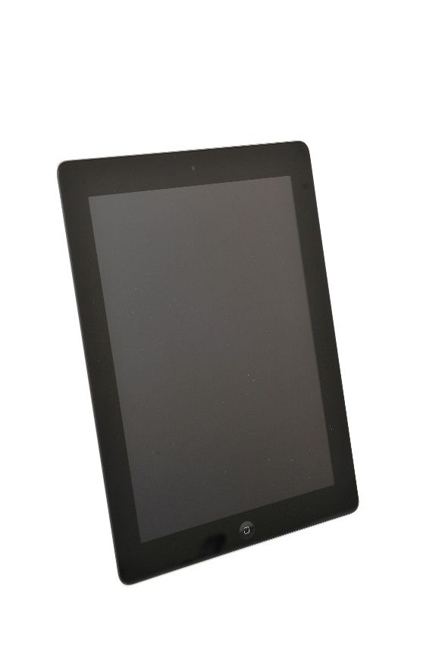
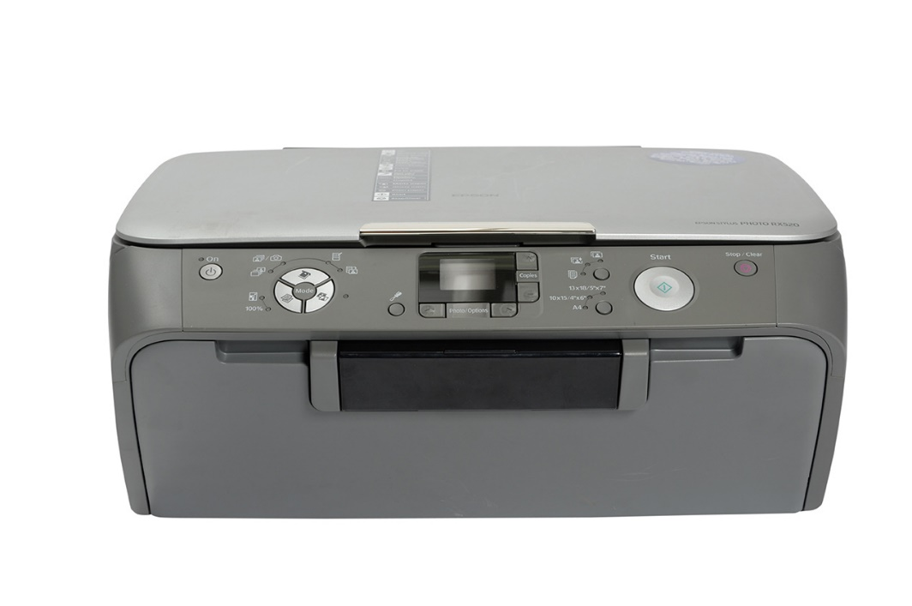
How many mobiles in the UK?
65 million phones
300,000 hoarded (not used)
Notes:
Pupils to guess how many mobiles are owned in the UK and to think about the amount of electrical/ electronic items that they own in their home.
Follow-on activity, could include pupils imagining what their life would be like without electrical/ electronic equipment.

Slide 3
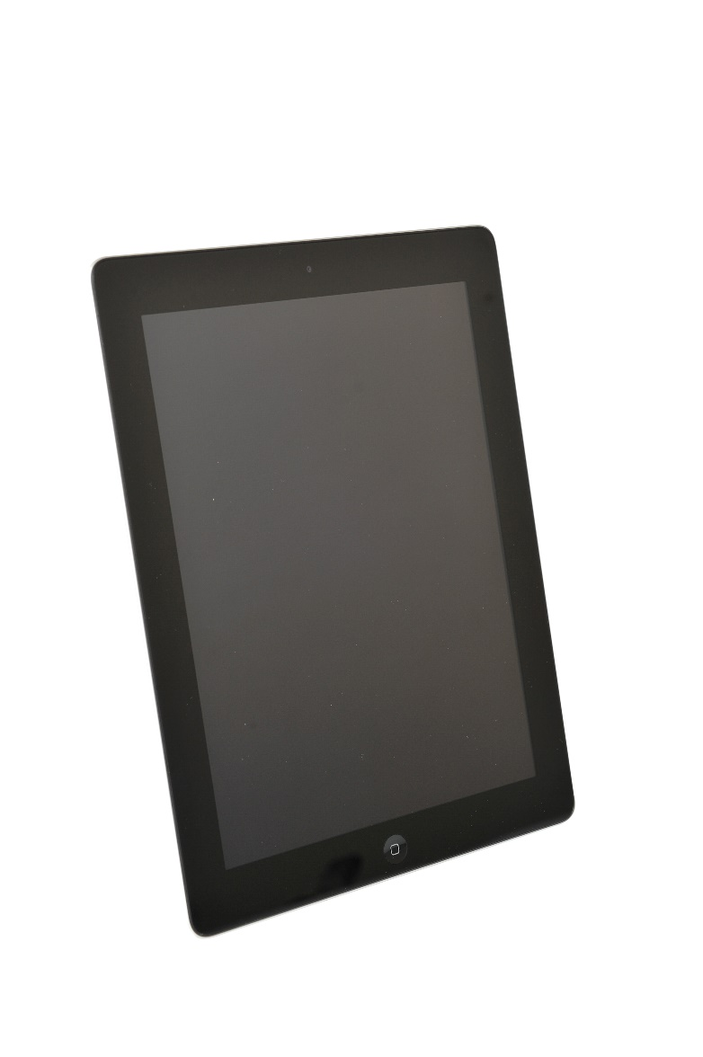
What elements are inside a tablet?
Electronics
Copper: Used for wiring.
Copper, Gold and Silver: Used for the microelectrical components.
Nickel: Used in the microphone.
Silicon: Used in the chip.
Copper, Silver & Tin: Used to connect the components (solder)
Screen
Glass: Usually strengthened to minimise cracking.
Rare Earth Elements: Used to give the screen colour.
Indium Tin Oxide: Enables the screen to act as a touch screen.
Casing
Plastic or Magnesium Compounds: Used for phone cases.
Battery
Lithium Ion: Typically used for battery
Aluminium: Used for battery casing.
Notes:
Description of items within a typical tablet. If your school has requested the resource pack, there is a framed tablet that has been broken apart to show the various components. Pupils to complete worksheet looking at number of miles travelled by an element.

Slide 4
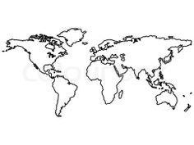
Where do critical raw materials come from?
Russia
Platinum Group metals
Canada
Cobalt
India
Graphite
Japan
Indium
China
Antimony
Beryllium
Fluorspar
Gallium
Graphite
Germanium
Indium
Magnesium
Rare Earths
Tungsten
USA
Beryllium
Mexico
Fluorspar
Rwanda
Tantalum
Brazil
Niobium
Tantalum
Democratic Republic Congo
Cobalt
Tantalum
South Africa
Platinum Group metals
Notes:
Electrical/ Electronic equipment contain lots of different elements from across the world, which need to be mined, processed and transported before manufacture.

Slide 5
Workshop Activity: What equipment can be reused and what equipment can be recycled?
Type of Equipment | Number | Does it work? | Could we re-use it? | Could we recycle it? | Worth (£)
Notes:
If your school has requested the resource pack, there will be several mobiles, tablets, laptops, etc that the children can switch on and see if they work. Items that work can be reused, items that do not work, will need to be recycled. Reusable items could be valued at £10 and recyclable items at £2 (for example).

Slide 6
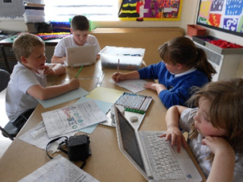
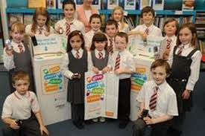
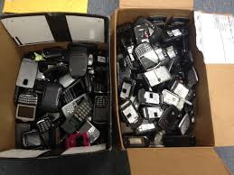
What can you do to help?
Notes:
Pupils could set up a collection scheme within their school, design posters and run a campaign and let people know what to do with electrical/ electronic items that they no longer need.

Slide 7
Why should we collect Electrical & Electronic Equipment?
Prevent waste
Help people
Save the environment
Make money for school

